Slide 1
Semantic Differentials for Wikipedia using the POLAR Framework
By Jan Engler
Ruixiang Wang

Slide 2
Content
Introduce Wikipedia and Word embeddings
The Polar Framework
Our Approach & Antonym Generation
Survey+ Evaluation
Conclusion and future directions

Slide 3

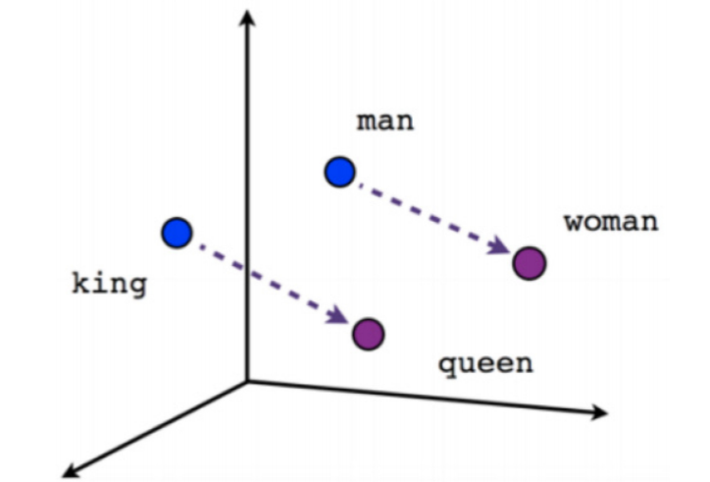
Why Wikipedia
English Wikipedia:
6 million articles with size over 12 GB compressed
→ very attractive as a corpus for machine learning
The vocabulary size is over 1.9 million: One-hot-bit encoding
Solution: Word Embeddings (e.g Word2Vec)
Integrate the semantics of the words into a vector
Fixed lower dimension (300 << 1.9million)

Slide 4
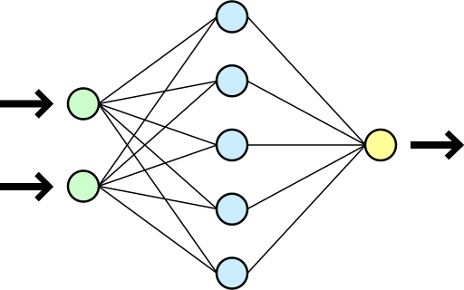


Problem Word Embeddings
y=(3.14,1.33,-4.2)
Guilty!
Missing Interpretability of dimensions and results
$\vec{King}$=(1.337,…,-42.24)
What does this mean?
?
Why?
?
?

Slide 5
Semantic differentials
Measure the semantics of words by:
Rating them on a scale between two polar opposites
Good vs Bad Beautiful vs Ugly
← Noble – Common →
← Male – Female →

Slide 6


The POLAR Framework [1]
Power - Weak
Male - Female
Transform pre-trained word embeddings into a “POLAR” space
Each dimension expresses a scale between two polar opposites
+ Get new word embeddings via POLAR transformation
+ Adds interpretability into pre-trained word embeddings
But: Retrieved antonyms from an Oracle
$\vec{King}$=(1.337,…,-42.24)
POLAR
Superman
Good
Bad
$\vec{King}$=(2.5, 1.4, -1.2, -0.8, 1,…)
Weak
Power
Female
Male
Money
Poor
Unpopular
Popular
Stand
Sit
-3 -2 -1 0 1 2 3

Slide 7
Our Approach
Train Word2Vec on Wikipedia
Choose categories
Generate context- specific antonyms
Apply Polar Framework
Evaluate Interpretability

Slide 8
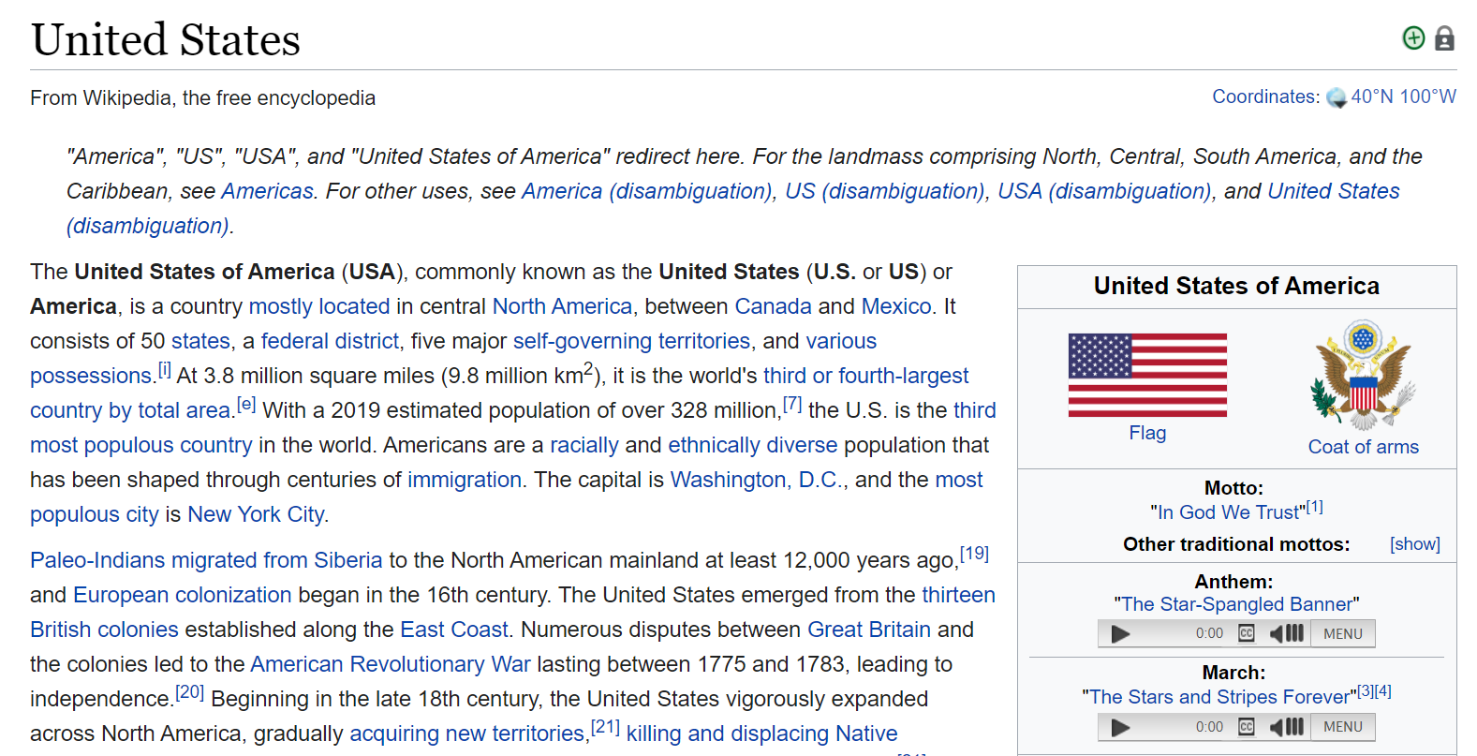
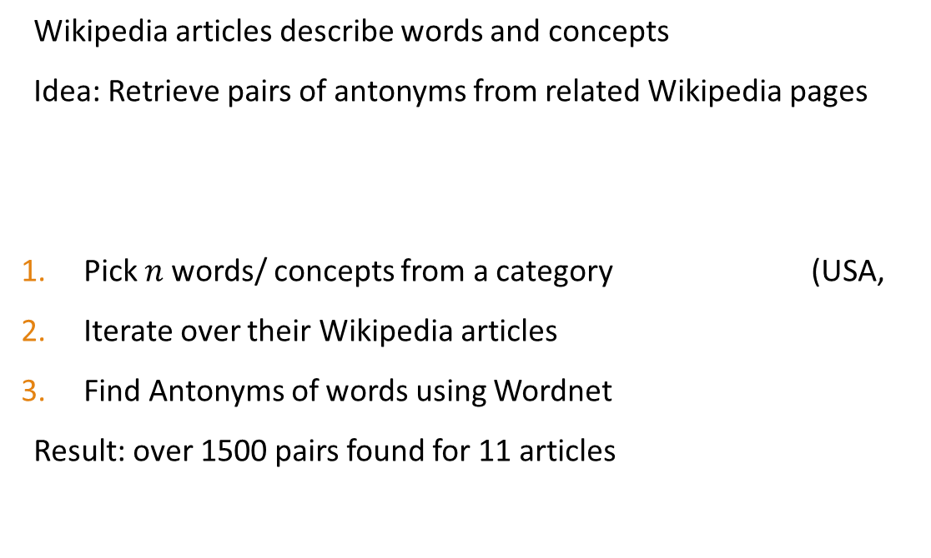
Antonym generation Approach: 1 of 3
Wikipedia articles describe words and concepts
Idea: Retrieve pairs of antonyms from related Wikipedia pages
Pick $n$ words/ concepts from a category (USA,
Iterate over their Wikipedia articles
Find Antonyms of words using Wordnet
Result: over 1500 pairs found for 11 articles

Slide 9
Properties
Advantages
disadvantages
Very easy, can be generalized
Can generate many pairs of antonyms pairs very quickly
Wikipedia article also include history and other additional information about concepts
→ Generated Pairs are very general
(How to select examples from a category?)
Examples:
(known, unknown), ('north', 'south’) , ('equal', 'differ'), ('urban', 'rural'), ('square', 'round'), ('most', 'fewest'), ('new', 'old'), ('export', 'import')

Slide 10
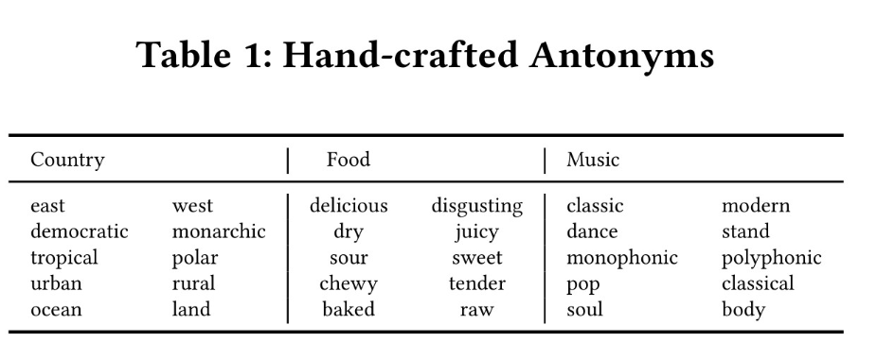
Antonym generation Approach: 2 of 3
→ Need of Initial set
Generate Antonyms by Hand
50 pairs of antonyms for each category
Advantages
disadvantages
High quality antonyms
Very category specific
Very tedious & time consuming
(Domain expert needed)
Too few!
…

Slide 11
Antonym generation Approach: 3 of 3
Extend hand-crafted antonyms:
Extend Initial set
Find synonyms
Find similar words (Word2Vec)
Add Antonyms
Wordnet
Online Dictionary (Crawl)
Input: salty
Similar Word | Antonym
savoury | tasteless
sour | sweet
spicy | mild
fruity | sane
Advantages
disadvantages
High quality antonyms
Very category specific
More antonyms than just hand crafted (usually 300+)
Initial set needed
Some general or overly specific antonyms
Rely on the Antonyms provided

Slide 12

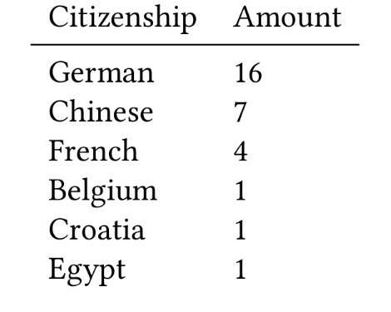
Survey
Question: Rate semantics of words on a scale between antonyms
Categories: Country, Food, Music
Words: USA, Germany, Salad, Rice, Pop, Rammstein
Polar picks most descriptive dimensions:
5 from hand-crafted and 5 from extended set
→ 1800 Answers
Average age: 23.5

Slide 13
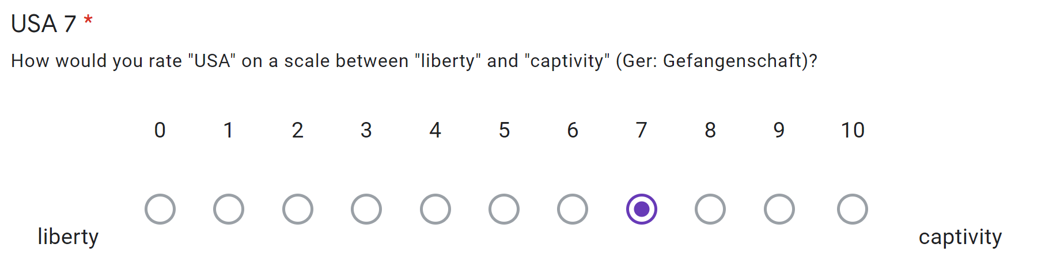
Overview
Mean
Std
Standard deviation ≈ 2
→ Very big variance in results

Slide 14
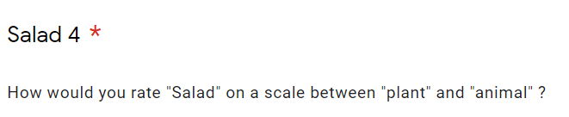
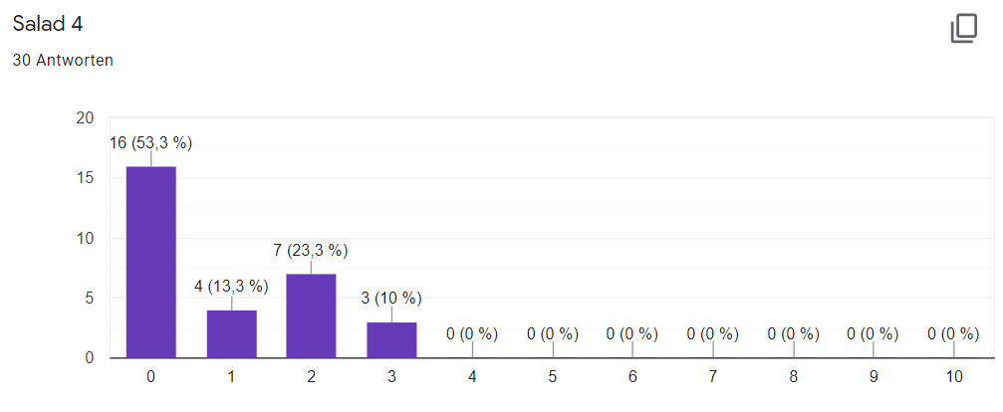
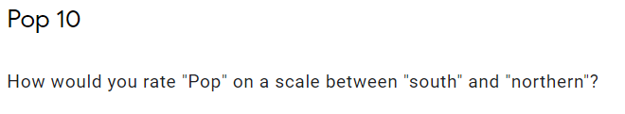
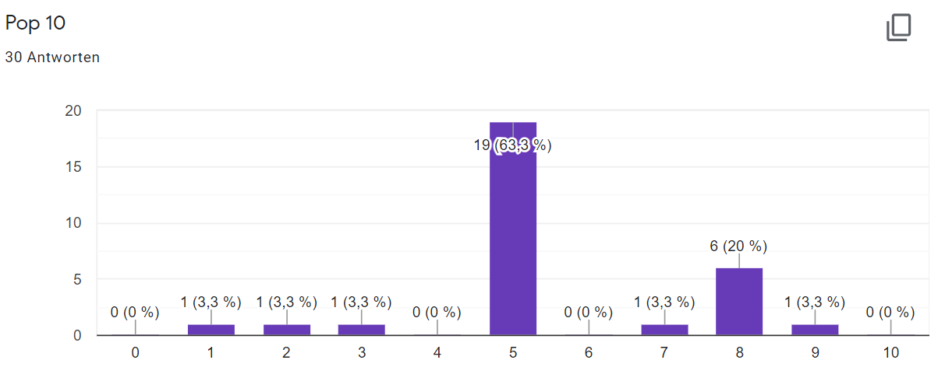
Results
Very good:
Expressive antonyms
Participants agree on vote
plant
animal
Very bad :
Non- expressive antonyms
south
northern

Slide 15
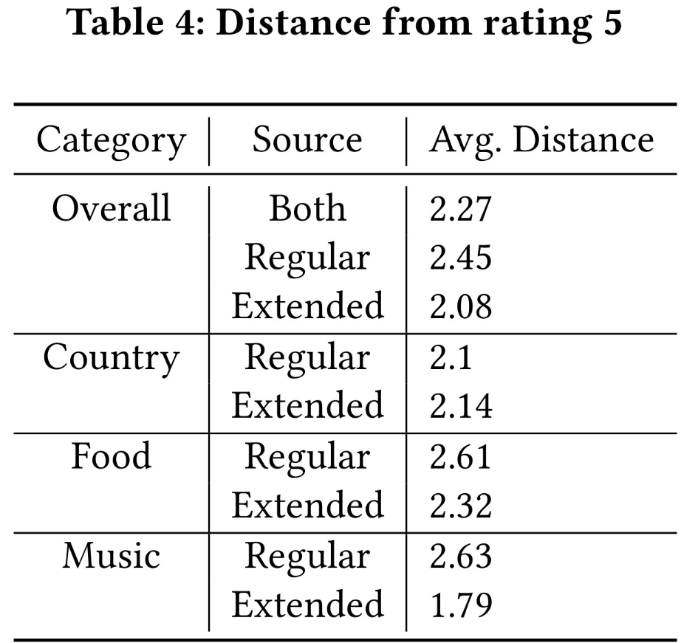
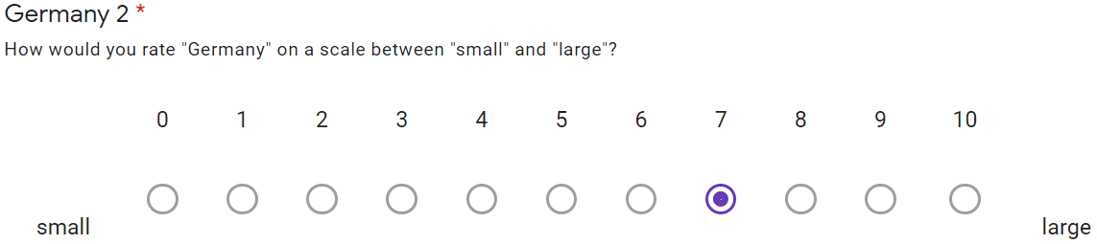
Evaluation of interpretability
Interpretability: Distance from rating 5
Good interpretability overall
Depending on category
Distance = 2

Slide 16
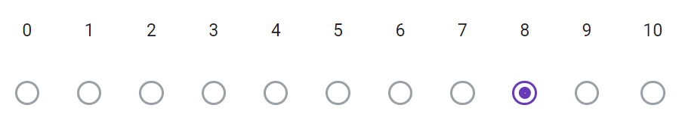
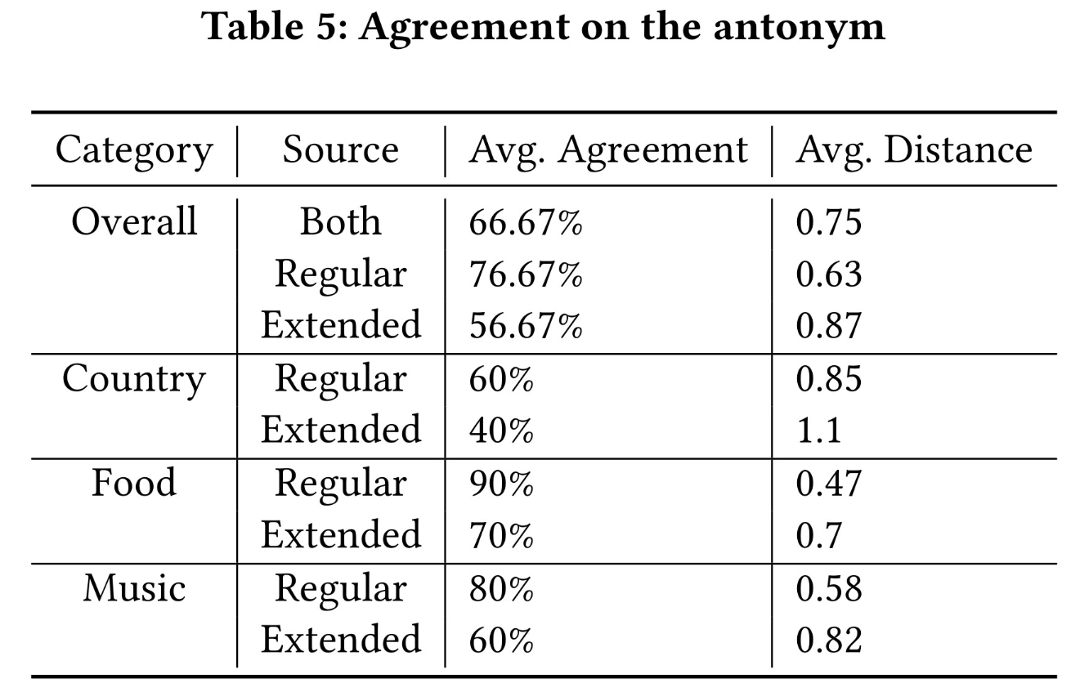
Evaluation of Agreement
?
Very high for hand-crafted antonyms
Significantly lower for generated antonyms
Gain valuable information from different opinions:
How does Word2Vec on Wikipedia “think”?
?
Antonym 1
Antonym 2
Polar
Survey

Slide 17
Conclusions
If initial set provided:
Highly descriptive antonyms
Usually high agreement on antonym
Depending on Category
Worst for concepts that are highly subjective (e.g. USA/ Countries)
Resources:
[1]:Binny Mathew, Sandipan Sikdar, Florian Lemmerich, and Markus Strohmaier. 2020. The POLAR Framework: Polar Opposites Enable Interpretability of Pre-Trained Word Embeddings. In Proceedings of The Web Conference 2020. 1548–1558.

Slide 18
Questions + Discussion

Slide 19
Resources
[1]: Binny Mathew, Sandipan Sikdar, Florian Lemmerich, and Markus Strohmaier. 2020. The POLAR Framework: Polar Opposites Enable Interpretability of Pre- Trained Word Embeddings. In Proceedings of The Web Conference 2020. 1548–1558.

Slide 20
Future Direction
Improved filtering of antonyms
Too general, or too specific
Extend the survey with more participants, categories etc.
Evaluate results of downstream tasks

Slide 21
Summary & Conclusions
Trained a Word2Vec model on Wikipedia
Used POLAR framework [1] to add interpretability
Generated pairs of antonyms for different categories
Evaluated with a survey
High interpretability if initial set provided
Resources:
[1]:Binny Mathew, Sandipan Sikdar, Florian Lemmerich, and Markus Strohmaier. 2020. The POLAR Framework: Polar Opposites Enable Interpretability of Pre-Trained Word Embeddings. In Proceedings of The Web Conference 2020. 1548–1558.

Slide 22
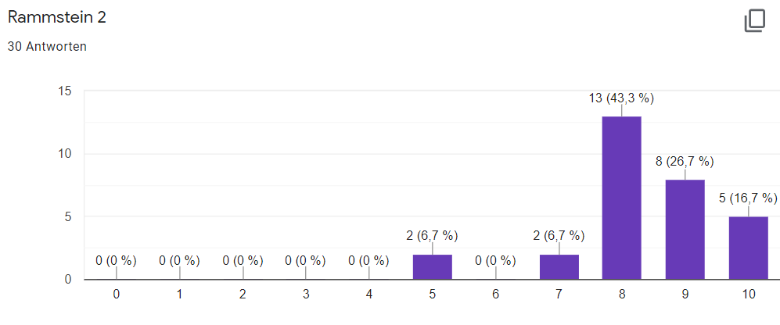
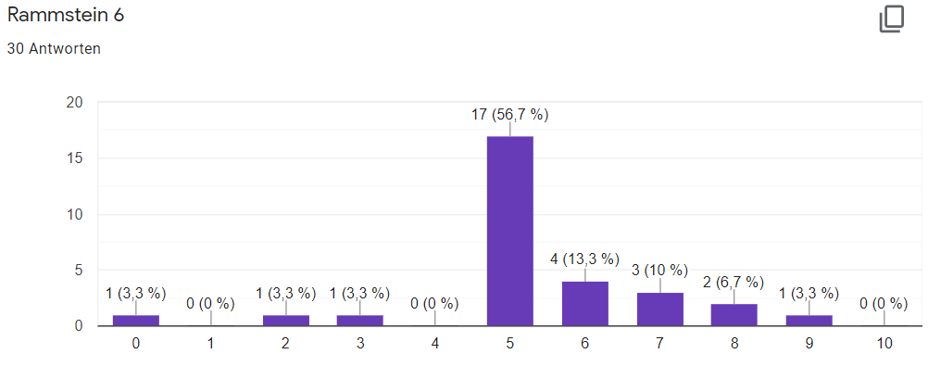
Hand-crafted
gentle
energetic
Generated
untruthful
truthful

